Slide 1

CSA0491-Operating System for process Scheduling
l
l
Guided By,
DR. G Mary Valentina
(Course System)
Operating Systems
SSE, SIMATS
Project by,
K. Bharatha Ratna, J. Jayanth Reddy, K. Vinod
(192224187, 192210046, 192211822)
Operating System
SSE, SIMATS

Slide 2

ABSTRACT
The Project aims to develop an enhanced Task Manager application for Android devices , building upon the functionality of existing Task managers.
The proposed Task manager will allow user to not only monitor running process but also terminated specific processes automatically based on user-define criteria.
Additionality the application will provide detailed insights into CPU utilization for each running process, users in managing system resource effectively.
Through this implementation, users will have a powerful implementation, users will have a powerful tool to optimize their device’s performance and streamline resource allocation.

Slide 3

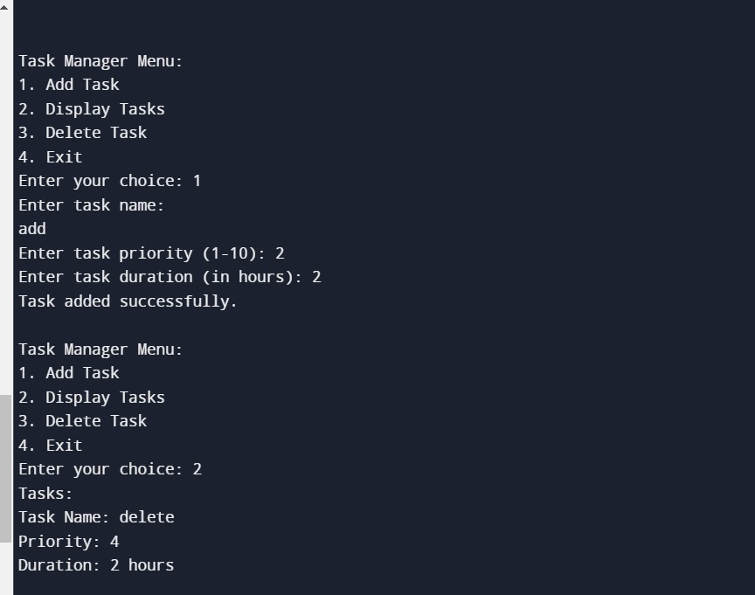
OUTPUT

Slide 4

INTRODUCTION
The primary objective of this project is to develop a Task Manager application that allows users to view running process.
In the world of android devices, managing tasks efficiently can greatly enhance performance and optimized device resources.
The Task Manager (Android) project aims to create a robust application that not only mirrors the functionalities of native android task manager but also introduce advanced features.
This app empowers users to make informed decisions to improve their devices performance and battery life.
Exploring its core features and how it address the need for efficient task management and resources optimization on android devices.

Slide 5

EXISTING SYSTEM
Existing Task Manager (Android) project aims to bridge this gap by enhancing the existing functionalities of native android task manager.
By integrating automatic process termination capabilities and providing detailed insights into CPU utilization for each process.
The current landscape of Task Manager on Android devices revolves around the native “Android” revolves around the native “Android Task Manager”.
While the built in task manager offers insights into active application and system resource, it lack the functionality to automatically terminated specific process based on user-criteria.

Slide 6

PROPOSED SYSTEM
The Task Manager(Android) project proposed an innovative solutions to the task management needs of android devices users.
Building upon the foundation of the native Android Task Manager, to enhance user control and optimize device performance
Key Features of Proposed System:
Automatic Process Termination.
Comprehensive Process Monitoring.
Intuitive User Interface.
Customizable Settings.
Enhanced Device Performance.

Slide 7

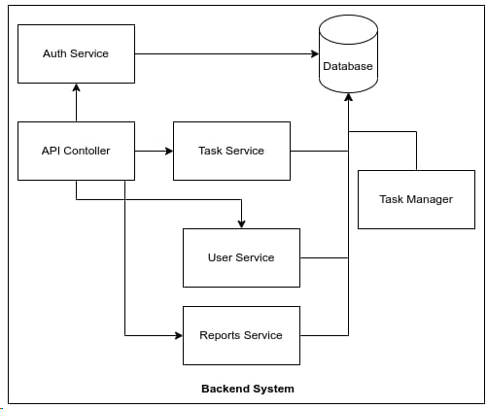
ARCHITECTURE

Slide 8

CONCLUSION
In conclusion, the development of the Task Manager app for android offers an innovative solution to streamline device management. By integrating the ability to automatically terminate designated process, alongside the display of CPU utilization data for each task, users are equipped with a powerful toolset for optimizing their device performance. Users with a comprehensive approach to managing their Android devices efficiently.

Slide 9

FUTURE SCOPE
Memory Optimization
Resource Monitoring
App Whitelisting/Blacklisting
Task Scheduler
Compatibility and OS support

Slide 10

LITERATURE SURVEY
A survey of current task manager application available on the Google Play Store and other platform will provide valuable insights into future, design, and experience aspects. Studies on automated process termination mechanism in task manager apps will be essential. Research papers, articles and documentation on algorithm, heuristics and best practices for safely and effectively terminating processes will guide the implementation for this future. By conducting a through literature survey encompassing these key areas, the “Task Manager(Android)” project aims to build a robust and future-rich application their devices processes and optimize performance.

Slide 11

REFERENCES
A task manager for virtual environments Murray, Terrence Fernando Proceedings of the Workshop on User-Centered Design and Implementation of Virtual Environments, 1999
The instructor as manager: Time and task Collis, GG Nijhuis - The Internet and Higher Education, 2000 – Elsevier
Sharing to-do lists with a distributed task manager Thomas Krefeld's, Elke Hinrichs, Gerd WoetzelProceedings of the Third European Conference on Computer-Supported Cooperative Work 13–17 September 1993, Milan, Italy ECSCW’93, 31-46, 1993
Real-time task manager for communications and control in multicar platoonsIsaac R Porche, Kwang Soo Chang, William Li, Pravin Varaiya Proceedings of the Intelligent Vehicles92 Symposium, 409-414, 1992

Slide 12


